Slide 1
Web Services
Distributed Computer Systems
CT024-3-3-DCOMS and Version VC1

Slide 2
Topic & Structure of The Lesson
Web Services
Characteristics of Web Services
Microsoft .Net
Grid

Slide 3
Learning Outcomes
At the end of this topic, You should be able to
Understand the web services
Understand the concept of gride

Slide 4
Key Terms You Must Be Able To Use
If you have mastered this topic, you should be able to use the following terms correctly in your assignments and exams:
Web Services
.Net
Characteristics

Slide 5
Web Services
Encompass a set of related standards that can enable computer applications to communicate and exchange data via the Internet
Technology and platform independent
Improve collaborative software development by allowing developers to create applications by combining code written in any language on any platform

Slide 6
General Characteristics
Each specific function in an application can be exposed as a separate Web service
Individuals or businesses can create their own unique applications by mixing and matching Web services that provide the functionality they need
Less error prone
Promotes software reuse

Slide 7
Microsoft’s .NET Platform
The .NET initiative
Includes the Visual Studio .NET integrated development environment
Enables programmers to develop Web services in a variety of languages, including:
C++
C#
Visual Basic .NET
However, .NET technologies are available only for Windows 2000 and XP
Extend the concept of software reuse to the Internet by allowing developers to reuse software components that reside on other machines or platforms

Slide 8
Sun Microsystems and the Sun ONE Platform
Sun ONE
Model for software development
Critical business information and applications are available at any time to any type of device, including cell phones and PDAs
Incorporates support for open standards
XML, SOAP, UDDI and WSDL,
Helps ensure high levels of interoperability and system integration

Slide 9
e-Infrastructure
e-Infrastructure builds on the inevitable increasing performance of networks and computers linking them together to support new flexible linkages between computers, data systems and people
Grids and peer-to-peer networks are the technologies that build e-Infrastructure
e-Infrastructure called CyberInfrastructure in USA
On this we superimpose high value multi-way organizations (linkages) supported by Grids with optimized resources and system support and supporting virtual (electronic) enterprises
Low multiplicity fully interactive real-time sessions
Resources such as databases supporting (larger) communities

Slide 10
A typical Web Service
In principle, services can be in any language (Fortran .. Java .. Perl .. Python) and the interfaces can be method calls, Java RMI Messages, CGI Web invocations, totally compiled away (inlining)
The simplest implementations involve XML messages (SOAP) and programs written in net friendly languages like Java and Python
Payment Credit Card
Web Services
WSDL interfaces
Portal Service
Security
Catalog
Warehouse
Shipping
control
WSDL interfaces
Web Services

Slide 11
Services and Distributed Objects
A web service is a computer program running on either the local or remote machine with a set of well defined interfaces (ports) specified in XML (WSDL)
Web Services (WS) have many similarities with Distributed Object (DO) technology but there are some (important) technical and religious points (not easy to distinguish)
CORBA Java COM are typical DO technologies
Agents are typically SOA (Service Oriented Architecture)
Both involve distributed entities but Web Services are more loosely coupled
WS interact with messages; DO with RPC (Remote Procedure Call)
DO have “factories”; WS manage instances internally and interaction-specific state not exposed and hence need not be managed
DO have explicit state (statefull services); WS use context in the messages to link interactions (statefull interactions)
Claim: DO’s do NOT scale; WS build on experience (with CORBA) and do scale

Slide 12
Philosophy of Web Service Grids
Much of Distributed Computing was built by natural extensions of computing models developed for sequential machines
This leads to the distributed object (DO) model represented by Java and CORBA
RPC (Remote Procedure Call) or RMI (Remote Method Invocation) for Java
Key people think this is not a good idea as it scales badly and ties distributed entities together too tightly
Distributed Objects Replaced by Services
Note CORBA was considered too complicated in both organization and proposed infrastructure
and Java was considered as “tightly coupled to Sun”
So there were other reasons to discard
Thus replace distributed objects by services connected by “one-way” messages and not by request-response messages

Slide 13
Web services
Web Services build loosely-coupled, distributed applications, (wrapping existing codes and databases) based on the SOA (service oriented architecture) principles.
Web Services interact by exchanging messages in SOAP format
The contracts for the message exchanges that implement those interactions are described via WSDL interfaces.

Slide 14
What is a Grid?
You won’t find a clear description of what is Grid and how does differ from a collection of Web Services
I see no essential reason that Grid Services have different requirements than Web Services
Geoffrey Fox, David Walker, e-Science Gap Analysis, June 30 2003. Report UKeS-2003-01, http://www.nesc.ac.uk/technical_papers/UKeS-2003-01/index.html.
Notice “service-building model” is like programming language – very personal!
Grids were once defined as “Internet Scale Distributed Computing” but this isn’t good as Grids depend as much if not more on data as well as simulations
So Grids can be termed “Internet Scale Distributed Services” and represent a way of collecting services together to solve problems where special features and quality of service needed.

Slide 15
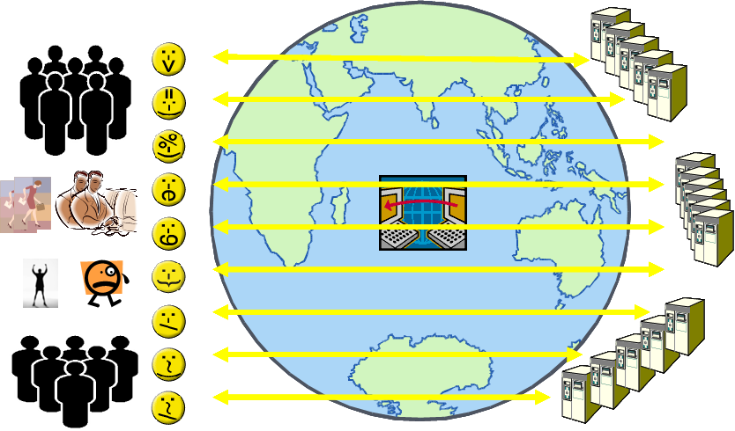
Community Resources
Grid Community databases have analogy to Television and the News Web that allow individuals to communicate instantly with each other via Web Pages and Headline News acting as proxies
N resources deposit information and N can view – Complexity O(N)

Slide 16
Large and Small Grids
N resources in a community (N is billions for the world and 1000-10000 for many scientific fields)
Communities are arranged hierarchically with real work being done in “groups” of M resources – M could be 10-100 in e-Science
Metcalfe’s law: value of network grows like square of number of nodes M – we call Grids where this true Metcalfe or M² Grids
Nature of Interaction depends on size of M or N
Shared Information O(N) Complexity Grids for largish N
Complexity M² Metcalfe Grids for smaller M < N
Grids must merge with peer-to-peer networks to support both Complexity O(N) and M² Systems

Slide 17
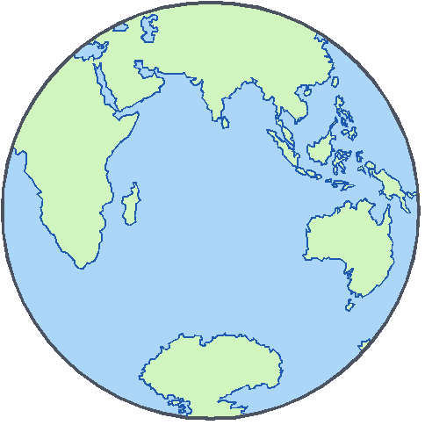

M² Interactions
Superimpose M² “Grids” on the sea (heatbath) of O(N) “ordinary” interactions

Slide 18
Architecture of (Web Service) Grids
Grids built from Web Services communicating through an overlay network built in SOFTWARE on the “ordinary internet” at the application level
Grids provide the special quality of service (security, performance, fault-tolerance) and customized services needed for “distributed complex enterprises”
We need to work with Web Service community as they debate the 60 or so proposed Web Service specifications
Use Web Service Interoperability WS-I as “best practice”
Must add further specifications to support high performance
Database “Grid Services” for O(N) Community case
Streaming support for M² case

Slide 19
Web Services WS-*
Java is very powerful partly due to its many “frameworks” that generalize libraries e.g.
Java Media Framework
Java Database Connectivity JDBC
Web Services have a correspondingly collections of specifications that represent critical features of the distributed operating systems for “Grids of Simple Services”
Some 60 active WS-* specifications for areas such as
a. Core Infrastructure Specifications
b. Service Discovery
c. Security
d. Messaging
e. Notification
f. Workflow and Coordination
g. Characteristics
h. Metadata and State
i. User Interfaces

Slide 20
A List of Web Services I
a) Core Service Architecture
XSD XML Schema (W3C Recommendation) V1.0 February 1998, V1.1 February 2004
WSDL 1.1 Web Services Description Language Version 1.1, (W3C note) March 2001
WSDL 2.0 Web Services Description Language Version 2.0, (W3C under development) March 2004
SOAP 1.1 (W3C Note) V1.1 Note May 2000
SOAP 1.2 (W3C Recommendation) June 24 2003
b) Service Discovery
UDDI (Broadly Supported OASIS Standard) V3 August 2003
WS-Discovery Web services Dynamic Discovery (Microsoft, BEA, Intel …) February 2004
WS-IL Web Services Inspection Language, (IBM, Microsoft) November 2001

Slide 21
A List of Web Services II
c) Security
SAML Security Assertion Markup Language (OASIS) V1.1 May 2004
XACML eXtensible Access Control Markup Language (OASIS) V1.0 February 2003
WS-Security 2004 Web Services Security: SOAP Message Security (OASIS) Standard March 2004
WS-SecurityPolicy Web Services Security Policy (IBM, Microsoft, RSA, Verisign) Draft December 2002
WS-Trust Web Services Trust Language (BEA, IBM, Microsoft, RSA, Verisign …) May 2004
WS-SecureConversation Web Services Secure Conversation Language (BEA, IBM, Microsoft, RSA, Verisign …) May 2004
WS-Federation Web Services Federation Language (BEA, IBM, Microsoft, RSA, Verisign) July 2003

Slide 22
A List of Web Services III
d) Messaging
WS-Addressing Web Services Addressing (BEA, IBM, Microsoft) March 2004
WS-MessageDelivery Web Services Message Delivery (W3C Submission by Oracle, Sun ..) April 2004
WS-Routing and Referral SOAP Routing Protocol (Microsoft) October 2001
WS-RM Web Services Reliable Messaging (BEA, IBM, Microsoft, Tibco) v0.992 March 2004
WS-Reliability Web Services Reliable Messaging (OASIS Web Services Reliable Messaging TC) March 2004
SOAP MOTM SOAP Message Transmission Optimization Mechanism (W3C) June 2004
e) Notification
WS-Eventing Web Services Eventing (BEA, Microsoft, TIBCO) January 2004
WS-Notification Framework for Web Services Notification with WS-Topics, WS-BaseNotification, and WS-BrokeredNotification (OASIS) OASIS Web Services Notification TC Set up March 2004
JMS Java Message Service V1.1 March 2002

Slide 23
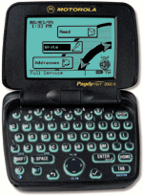
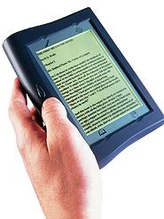
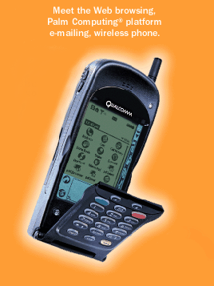
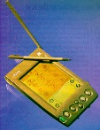


Peer to Peer Grid
Database
Database
Peers
Service Facing Web Service Interfaces
Event/ Message Brokers
Event/ Message Brokers
Event/ Message Brokers
Peers
User Facing Web Service Interfaces
A democratic organization
Peer to Peer Grid

Slide 24
Summary
Encompass a set of related standards that can enable computer applications to communicate and exchange data via the Internet
Technology and platform independent
Less error prone
Promotes software reuse

Slide 25
Question and answer session
Q & A

Slide 26
What we will cover next
Shared Objects and Serialization

